Slide 1

LUNCH & LEARN
Tuesday, Jan 5th, 2021
How to Build a Simple Real Estate Proforma

Slide 2


Amy M. Chhom
www.CHHOMGROUP.com
Amy@ChhomGroup.com
Real Estate Services Firm consists of a team of five licensed real estate agents specializing in Commercial and Residential Real Estate Transactions and Consulting Services to include Owner’s Representation, Investment Analysis, Pre-Acquisition Due Diligence/Feasibility, and property “turn-around” planning.
Notes:
2002 - Started in Property Management, Metropolis
2005 - Obtained Real Estate License, Anagnost
2008 - Worked on largest development project during recession, Elliot
2014 - Began working for fast growth tech start - up Dyn
2017 - Concord Hospital & BAE
2018 - Started Chhom Group - Keep my Commissions - Never planned to have agents working under me
2019 - Spearheaded The Factory on Willow - Life Goal
2020 - Started working for myself, providing consulting and real estate services

Slide 3

Notes:
How to Build a SIMPLE Real Estate Proforma
AKA Real Estate Investment Analysis
AKA Financial Modeling
Regardless of what you call it, its an important tool in Real Estate investing.

Slide 4

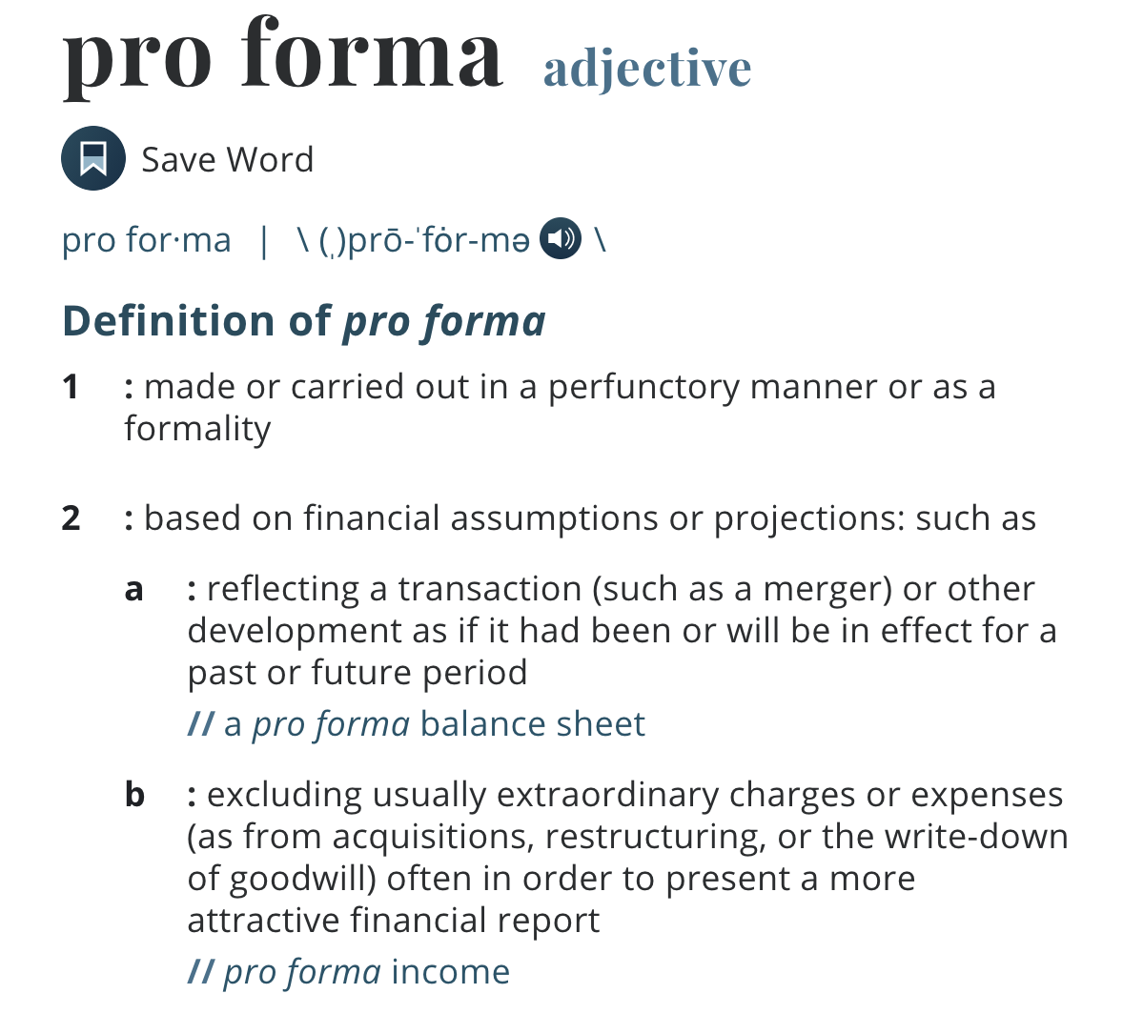
Notes:
Can be done for any size or type of real estate, including single family homes, but are more often seen with Multi-family or commercial properties.

Slide 5

Notes:
Yes - You can google “Real Estate Pro-Forma” and find all sorts of templates and examples all over the internet. But unless you understand what it is you need to calculate, then you run the risk of making errors.
In this presentation, I will provide you the basics of a building a pro-forma using a 2 family property that was recently sold in manchester, NH as an example.

Slide 6

Notes:
Bits and Pieces you need to build a proforma

Slide 7

The Basics
A Property
Purchase Price
Estimated Closing Costs
Loan Rate & Terms
Notes:
Investment Properties will often require 5% down as a MINIMUM. Every lender has different requirements but you will need to plan to have some cash available for your down payment. Some people get investors to contribute towards the equity and then they share the profits, but in this analysis we are focusing on a “first time investor”.

Slide 8

The Income
Current Rents
Potential Rents
Lease Terms
Utilities/Services - Who Pays?
Vacancy Rate
Notes:
Current Rents - What is the property currently receiving in rent
Potential Rents - What is the market getting for rents
How long are the leases in place, if any. If Rents are below market, you will want to increase them.
Who pays what utilities or services
Water
Sewer
Trash
Snow Removal
Landscaping / Grass Cutting
Electric
Heat
Hot Water
Trash
When you buy a property from a seller that uses a realtor, they are required to disclose all of this information.
Ask once, Verify twice
You can call utility companies asking for historic figures
Home Inspectors don’t catch everything - may want to call utility companies for meter information

Slide 9

The Expenses
Utilities - Common Area
Routine Maintenance
Taxes - RE and BPT
Misc. Unexpected Repairs
Unit Turns
Property Insurance
Notes:
Utilities
What is not paid by the tenants and the landlord needs to cover
Exterior Lights
Hallways - Electric & Heat
Routine Maintenance
Landscaping - Grass Cutting, Plants, Tree Maintenance
Snow Removal - Stairs, Driveway, Sidewalks
Painting
Cleaning / Vacumning
Taxes
Real Estate - in Manchester, 2x Year, 6 Months
Might be included in your mortgage payment
Business Profits Tax
If owning for investment vs. Owner occupied
7.5% - Income from conducting business activity within the state. - I always us 10% to be safe
Every business organization with gross business income from all business activities of more than $50,000 must file a BPT return.
Like they say in Big Brother - expect the unexpected
Toilet Leaks
No Heat
Broken Windows
And that’s why you want Insurance - for the big things.
Don’t forget the deductible

Slide 10

The Big Stuff
Capital Repairs
aka
Large Dollar Items
Notes:
What is the remaining effective life of the major components of the house?
A home inspector can tell you, but also reports are issued all the time. - National Association of Home Builders
Study of Life Expectancy of Home Components that I like to refer to.
Everything has a life span - All depends on the make, model, and material
Roofs - Asphalt Shingle - 20 Years
Furnaces - 15 - 20 Years
Appliances - Dryers & Refrigerators - 13 Years
Gas Stoves - 15 Years
Dishwashers / Microwaves - 9 Years
Garage Door Openers - 10 - 15 Years
LINK TO REPORT

Slide 11

Notes:
Now it’s time to do the math
Excel is your best friend

Slide 12
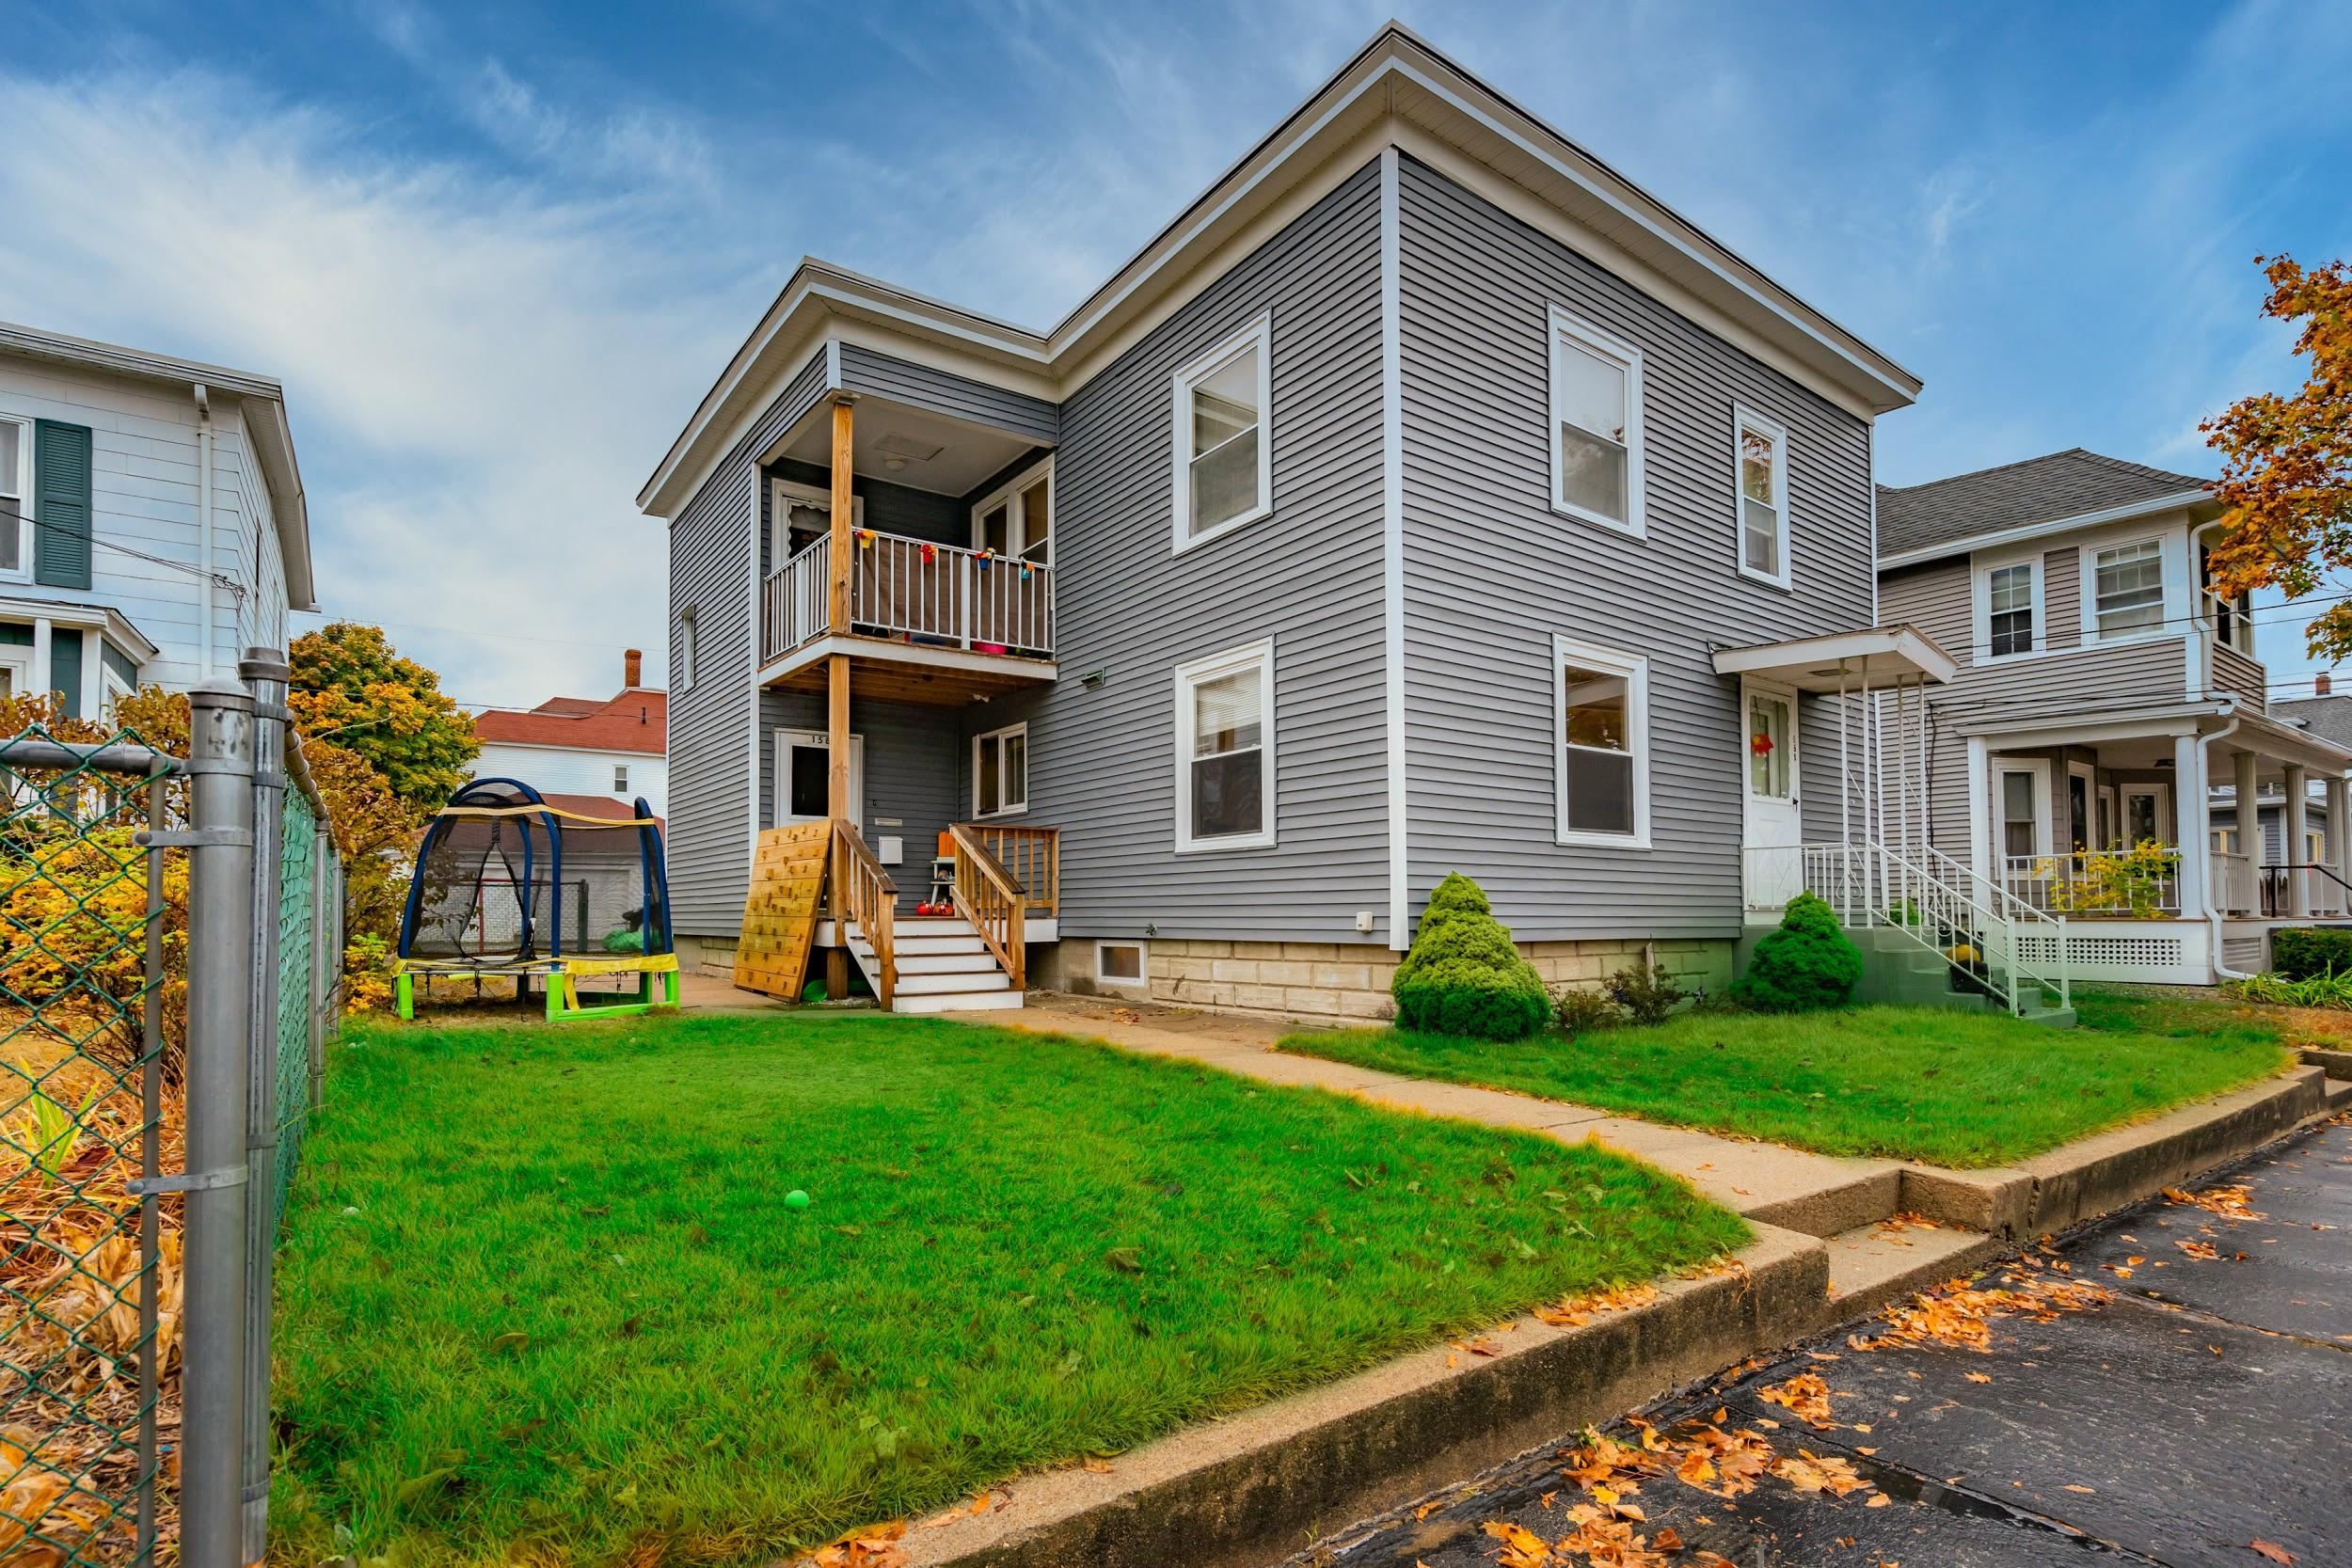
Example Property
2 Family Property - Manchester
2 Bedroom, 1 Bath each unit
Renovated Bathrooms - Tile
New Roof, New Siding, New Decks
Oversized Garage - 2 Car + Storage
Separately Metered Electric
Single Boiler Heat / Hot Water
Partially Finished Basement
Public Water/ Public Sewer

Slide 13
Building The Proforma
Down payment | Purchase Price | Mortgage Amount | Interest Rate | Years/Months
5.00% | $325,000.00 | $308,750.00 | 4.00% | 30
 |  | $1,474.02 | 0.00333 | 360
 |  | Monthly PITI | $984.10 | $489.92
 |  |  | Interest | Principal
Total Down Payment Requirement Based on Purchase Price (against loan) | $16,250
Notes:
Purchase Price - What your willing to offer a seller on a property.
Estimated Closing Costs - You can obtain these from a lender that you are working with
Loan Rate & Terms - For this analysis, I am assuming a 4%, 30 YR, Loan - I like to be conservative. But again, a lender can tell you rates - they change every day,
Excel and other programs can calculate for you automatically the Principal and Interest payments if you understand the formulas.
In google Sheets its as simple as =PMT(Interest rate divided by 12, number of months you will have the loan (ie. 30 yrs x 12 = 360), and Mortgage Amount as a negative number) and voila its magic! It calculates it for .

Slide 14
Closing Costs
Appraisal Fee | $600.00
Credit Report | $75.00
Loan Origination Fee: | $1,543.75
Closing Fee | $675.00
Title Insurance | $1,667.25
Recording Fees | $175.00
Transfer Stamps | $2,437.50
PMI Insurance Up Front Premium | $0.00
Interest - Prorated Based on Closing | $984.10
Pro-Rated Real Estate Taxes | $1,192.29
Total Closing Costs | $9,349.88
Tax Escrow | $2,384.58
Insurance Escrow | $1,500.00
Total Reserves | $3,884.58
Notes:
Appraisal Can average between $500 - $1000 usually paid during due diligence period, before closing depending on size of property.
Credit Report Reimbursed to the Mortgage Company or Lender at closing as part of closing costs
Loan Origination Fee - Used .5% for this analysis - can be up to 1 Point (1% of Loan Amount) (varies by Lender)
CLosing Fee - estimate - varies by Title Company
Title Insurance estimated - Based on Purchase Price - .0054 of Loan Amount
Recording Fees - estimated - Based on Pages in Loan Doc
Transfer Tax - There is no getting out of this one - $15.00 per $1000 split 50/50
Reserves are for lenders that require you to escrow your taxes and insurance as part of your monthly payments - it creates a cushion in your escrow account so that there is always sufficient funds for them to pay your insurance and your Taxes on your behalf.

Slide 15
Total Cost to Purchase
Total Down Payment | $ 16,250.00
Total Closing Costs / Reserves | $ 13,234.46
Total Estimated Cash to Close | $ 29,484.46
Notes:
So assume you need to have $30,000 cash total to put down on a property
It would be good to also have 3 Months Expenses Saved up while you lease out the vacant unit. - $6,000

Slide 16
The Income
Income | Monthly | Annually
Unit 1 - 2 Bedroom, 1 Bath | $0.00 | $0.00
Unit 2 - 2 Bedroom, 1 Bath | $1,200.00 | $14,400.00
Total Income: | $1,200.00 | $14,400.00
The Facts
Unit 1 is owner occupied - they will be moving out as part of the sale
Unit 2 is a tenant that has been there for multiple years, but the lease is expiring at the end of February
Each Tenant pays their own Electric
Heat and Hot Water are included in the rent (There is only one furnace and hot water tank)
Landlord/Owner currently pays for all other expenses (Water/Sewer, RE Taxes, Etc.)
Landlord/Owner currently handles Snow Removal and Landscaping themselves

Slide 17
The Expenses
Expenses
Electric | $150.00 | $1,800.00 | Owner's Electric (Estimated)
Heat & Hot Water | $156.66 | $1,879.96 | Based on 1 Years consumption (1045 Gallons x $1.80)
Misc. Repairs | $100.00 | $1,200.00 | Could be Emergency Repairs or Save for Unit Turns
Water / Sewer | $90.00 | $1,080.00 | Estimated Consumption $270/Quarter
Snow Removal | $0.00 | $0.00 | Performed by Owner
Landscaping / Mowing | $0.00 | $0.00 | Performed by Owner
Property Insurance | $125.00 | $1,500.00 | Based on Current Policy in place by Seller on Disclosure
Real Estate Taxes | $406.25 | $4,875.00 | Based on Full Year Taxes
Mortgage Principal and Interest | $1,474.02 | $17,688.24 | Based on your Loan
Total Expenses | $2,501.93 | $30,023.19

Slide 18

Income Vs. Expense
Total income | $14,400.00
Total Expense | $30,023.19
Net Operating Income | -$15,623.19
Notes:
Stop! Whay would you purchase a property you are going to lose money on!?!?!?
Well first, let us remember that this was an owner occupied unit - so although they lost money, it meant that their monthly living expenses all in were about $1300/Month - utilities included. Not Bad!
And this young couple purchased this property only 5 years ago and the property value increased that they were able to buy a bigger 2 family to owner occupy and have 20% down payment.

Slide 19

But What if?
Notes:
This is where a Pro-Forma becomes the most useful. Remember - it’s about what it could be with patience, hard work, and know how.
Perform a market study and you see that similar units are renting for $1650 per month - WITHOUT UTILITIES INCLUDED
That you know a Garage is valuable to any tenant and you could potentially get more rent for the garage - $100Month
And you know the value of the Heat and Hot Water being included is worth at least another $100- $150/Month
That means you could increase the income for both units!

Slide 20
What If Scenario
Income | Monthly | Annually
Unit 1 - 2 Bedroom, 1 Bath | $1,800.00 | $21,600.00
Unit 2 - 2 Bedroom, 1 Bath | $1,750.00 | $21,000.00
Garage - Space 1 | $100.00 | $1,200.00
Garage - Space 2 | $100.00 | $1,200.00
Total Income: | $3,750.00 | $45,000.00
Notes:
Discounted the 2nd Floor a bit because it has a smaller kitchen and is on the 2nd floor.
Washer Dryer is in the basement and there is no dishwasher. But it does have a private deck.
Additional Income could be made through charging for pets & having Coin Operated Laundry Machines - but right now… I am leaving that out of this.

Slide 21

Gross Rental Income
Current | $14,400.00
Potential | $45,000.00
Increase | $30,600.00
Notes:
Just by Increasing the rent to Market Rate, I have increased my potential Gross Income BEFORE EXPENSES by $30,600
You should always plan for a vacancy rate. Currently in Manchester, it is less than 2%, but lenders will likely underwrite your property with a 5% - 10% Vacancy rate Which in this case $3060 a year. But for this simple proforma, I have left the vacancy rate out. Because I know if I have a vacancy, I am going to be able to rent it within a month because of the market.

Slide 22
What if Expense?
Expenses
Electric | $150.00 | $1,800.00
Heat & Hot Water | $156.66 | $1,879.96
Misc. Repairs | $100.00 | $1,200.00
Water / Sewer | $90.00 | $1,080.00
Snow Removal | $50.00 | $600.00
Landscaping / Mowing | $50.00 | $600.00
Property Insurance | $125.00 | $1,500.00
Real Estate Taxes | $406.25 | $4,875.00
Mortgage Principal and Interest | $1,474.02 | $17,688.24
Total Expenses | $2,601.93 | $31,223.19
Notes:
No way I am going to handle snow removal myself or cut the grass. Worth every penny to hire someone.
You might find other ways to save money, but I have kept all the other expenses the same as the current proforma except for snow removal and landscaping.

Slide 23
Revised NOI
Total income | $45,000.00
Total Expense | $31,223.19
Net Operating Income | $13,776.81
Notes:
Net Operating Income.
Income after Expenses have been paid
Note: Gross Income is less than $50,000 so no BPT is required to be paid - 7.5%
But you will be taxed as income - Talk to an accountant. They can also help you with Depreciation tables which saves you on your taxes
Remember, with the vacancy rate, this would be a NOI to a lender of about 10,000/year.

Slide 24
Return on Investment
Net Operating Income - Annually | $13,776.81
Original Down Payment & Closing Costs | $29,484.46
ROI = NOI divided by Cash (Equity) | 46.73%
Notes:
Tell me what bank is currently giving you 46% interest on your money today!

Slide 25

Key Reminders
Protect, Enhance,and Maintain the Asset
Don’t Spend the Money
Learn Landlord and Tenant Laws
Hire an Accountant
Vacancies Happen
Notes:
Protect, Enhance,and Maintain the Asset - Its not a Set and Forget it type of Investment
Don’t Spend the Money - Create a Safety Net for Unforeseen Repairs / Replacements
Learn Landlord and Tenant Laws - New Hampshire Legal Aid
Hire an Accountant to handle your taxes - Identify Savings, Depreciation, and other related opportunities
Pay Down Principal or Refinance to shorter loan term in future
Redeploy the equity after refinance to purchase your next investment
Vacancies Happen - Save to cover the expenses when an apartment is vacant - Good rule of thumb is 3 Months Expenses

Slide 26
Key Reminders
I repeat - don’t spend the money!
Pay Down Principal
Refinance for shorter term loan
Pull out equity to purchase next investment property.
Notes:
Protect, Enhance,and Maintain the Asset - Its not a Set and Forget it type of Investment
Don’t Spend the Money - Create a Safety Net for Unforeseen Repairs / Replacements
Learn Landlord and Tenant Laws - New Hampshire Legal Aid
Hire an Accountant to handle your taxes - Identify Savings, Depreciation, and other related opportunities
Pay Down Principal or Refinance to shorter loan term in future
Redeploy the equity after refinance to purchase your next investment

Slide 27

Why?
18.5 Loan Term
48 Years old
Notes:
I know you are like - Why can’t I spend any money? Why have it if I can’t enjoy it?
But I want to go to Fiji!
Now listen carefully… This is the good stuff.

Slide 28

Why?
30 Years Old
Notes:
Imagine you are purchasing this property at the age of 30. You have a good job making $45,000 / Year but goals to move up through the company over time.
Get Married
Have Kids
White Picket Fence
Or not… of course. You just want financial stability in the future.

Slide 29

Why?
3 Years and 5 Months
Notes:
$100 / Month reduces your loan by 3 Years and 5 Months - about the age of a toddler…
And $100/ Month will hardly be missed on a property that you plan on putting the money away for

Slide 30

Why?
11 Years and 6 Months
Notes:
Current Estimated Monthly Proceeds = $1150/Month - $500 is less than half - The balance you save towards expenses.
$500/Month additional payment reduces your loan by 11 years and 6 Months
Or about the time it takes to raise a tween…

Slide 31

Why?
18.5 Loan Term
48 Years old
Notes:
Assuming nothing changes with the variables (Income or Expense),
you supplement your future income earning annually by $31K because you have paid off the Mortgage
So if you moved up in the company and now make $70,000 / Year - your total annual income will be 6 Figures!
And if you followed my advice, you would have saved over $100,000 Dollars
Plus over $90,0000 in Interest by paying loan early.

Slide 32
Why?
$100,000
$90,000
Notes:
And if you followed my advice, you would have saved over $100,000 Dollars
Plus over $90,0000 in Interest by paying loan early.

Slide 33
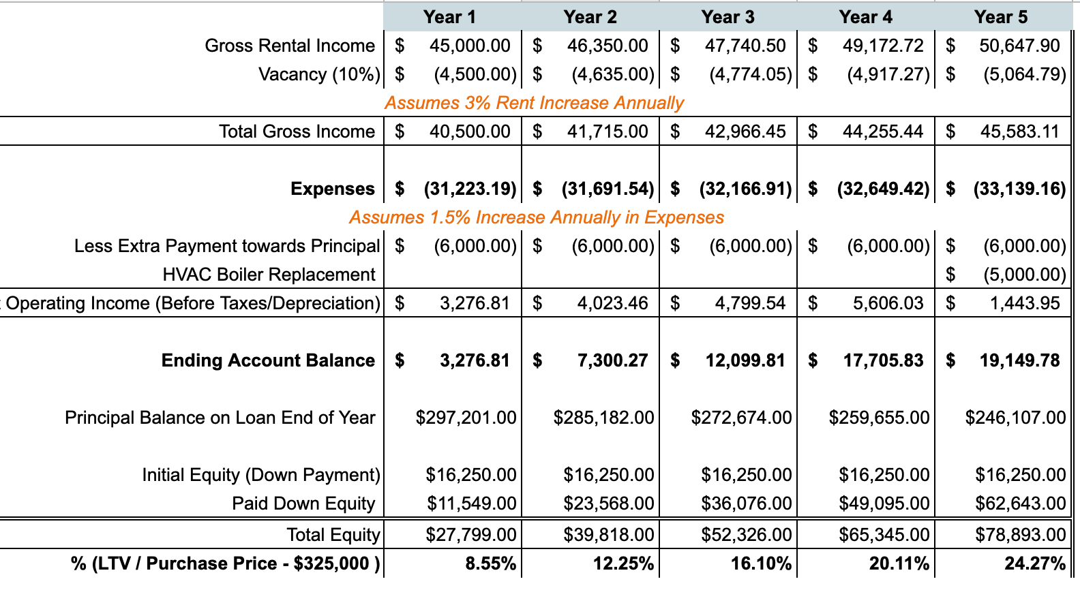
Cash Flow Projection
Notes:
But let’s be honest, Rents will increase and you will be making more money and now you have an asset that is likely worth more also. So you could increase your net worth significantly and use the equity to buy other properties in a short amount of time!
This is called a cash flow projection. Which looks at how rents will increase and expenses and you can model what 1 year, 5 Years, or 20 Years might look like and project when you may have a major capital improvement need.
Which for this property the HVAC may need to be replaced
in the first 5 years - but the roof, siding, and decks should last us at least 20 with them being new.
Always prepare for the unexpected! But also, at the end of Year 5, Inow have 20% equity. I could refinance, and possibly tap into some of that equity to buy my next property because I like it so much!

Slide 34

Why?
$525,000
Notes:
The value of the property will likely increase over time, so you may have an asset you bought for $325,000 - let’s assume its worth $425,000 in 18 Years (It could be more) And over the 18.5 Years, you saved (hopefully) or earned $100,000 +/- (1150 - 500 = $7800 x 18.5 Years)
Making your total net worth increase over a half of million dollars! Cash Liquidity
You can borrow against this and more!
And now that the mortgage is paid off, you can start taking vacations and distributions without worry.
But let’s be honest, Rents will increase and you will be making more money and now you have an asset that is likely worth more also. So you could increase your net worth significantly and use the equity to buy other properties in a short amount of time!

Slide 35

Why?
College Tuition
FInancial Security
Notes:
But here is the real goals.
You control your financial security and future - not relying on employers
If you decide to raise a family, you can use this to help pay for college
You can retire early!

Slide 36
Summary
Gross Rental Income Potential
Less Vacancy Rate (10%)
= Total Income
Less Expenses
Less Mortgage
= Net Operating Income ← Cash Flow
Earnings before Depreciation and Income Tax
Notes:
But here is the real goals.
You control your financial security and future - not relying on employers
If you decide to raise a family, you can use this to help pay for college
You can retire early!

Slide 37
Ask Me Anything
Amy M. Chhom
www.CHHOMGROUP.com
Amy@ChhomGroup.com
Notes:
2002 - Started in Property Management, Metropolis
2005 - Obtained Real Estate License, Anagnost
2008 - Worked on largest development project during recession, Elliot
2014 - Began working for fast growth tech start - up Dyn
2017 - Concord Hospital & BAE
2018 - Started Chhom Group - Keep my Commissions - Never planned to have agents working under me
2019 - Spearheaded The Factory on Willow - Life Goal
2020 - Started working for myself, providing consulting and real estate services

